Slide 1
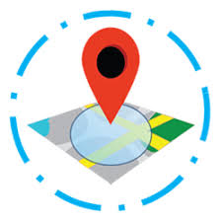
Geofencing with Task Management
Presented by: Hemant Upadhyay
Neelam Gujar
Aditi Chaukekar
Gaurav Kapurkar
From Government Polytechnic Mumbai
Guided by: Lect. Madhuri Arade

Slide 2
Outlines :-
What is Geofence?
Applications
Existing System
Proposed System
Future Scope

Slide 3
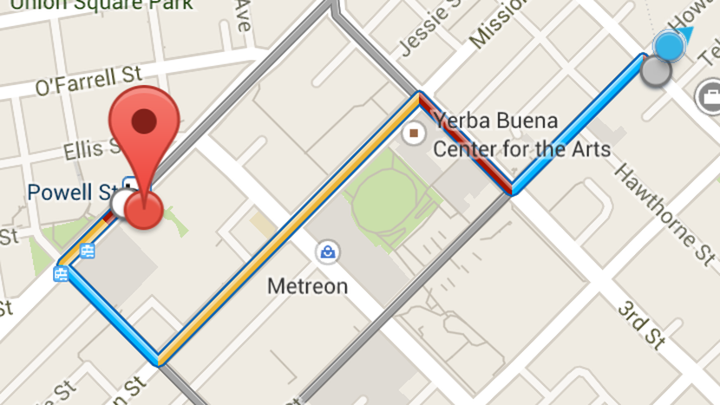
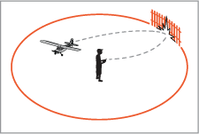
Fence
Geo

Slide 4
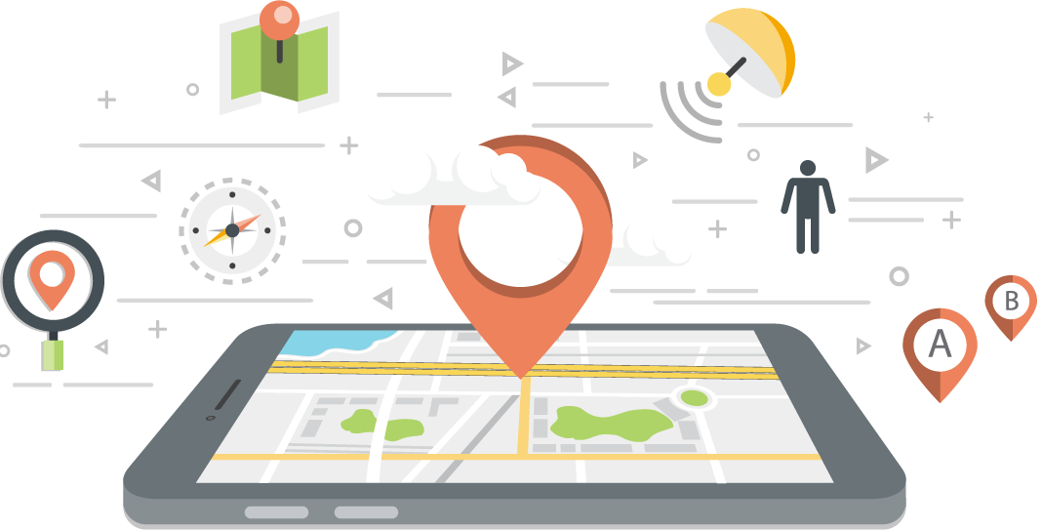
Geofence (virtual barrier on geo - location)

Slide 5
What is Geofence?
Geofencing is a technology that defines a virtual boundary around a real-world geographical area. In doing so, a radius of interest is established that can trigger an action in a geo-enabled phone or other portable electronic device.
Applications :-
Child & Elder Care
Pet Tracking
Fleet Management
Marketing
Marines

Slide 6

Existing System :-
The present invention generally relates to device tracking, and for ensuring location adherence for a tracked device as well as ensuring route adherence by employing geofencing techniques.
Examples are Sephora, Spyzie, Kaspersky kids safe,etc.
One of the first uses of geofencing was with cattle.
Farmers would equip a herd of cattle with GPS units. When the herd of cattle would move out of the geofence set by the rancher, the rancher would receive an alert in text messages.

Slide 7
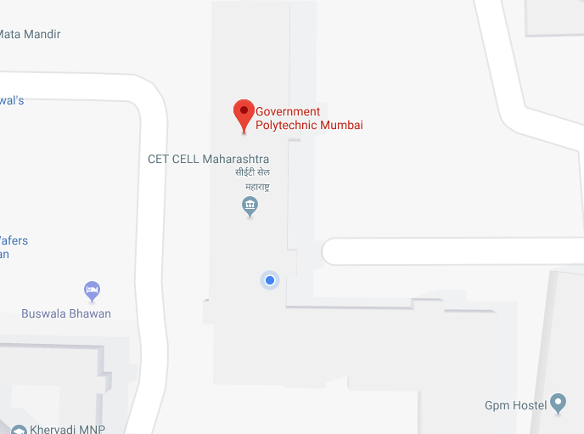
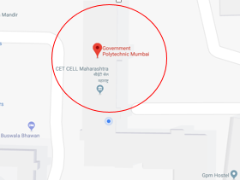
How our Proposed System starts?
Let us take an Example,
Geofence created over the college campus
Teacher is about to enter into College campus i.e into geofenced area.

Slide 8
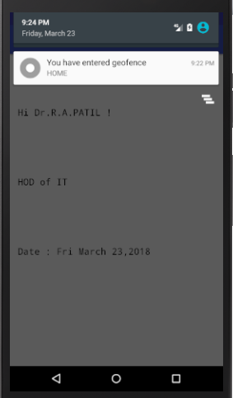
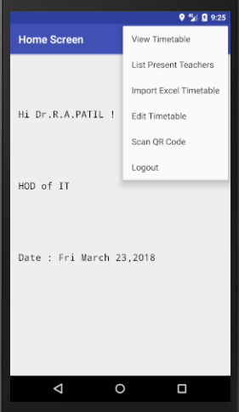
Teacher/HoD gets notified,when he/she enter into geofence.
Now he/she is able to access the app functionality & in background her attendance will get marked with that timestamp.
Teacher/HoD can access all he functionalities,until and unless he/she is in geofenced area.

Slide 9
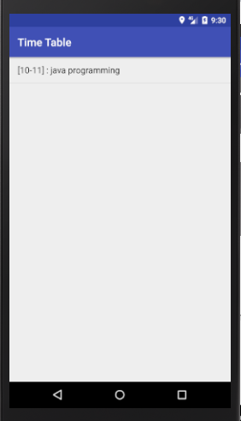
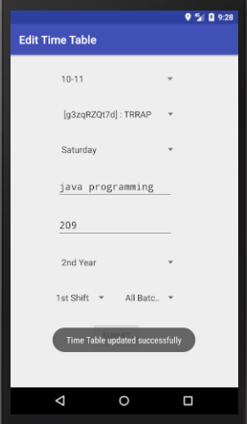
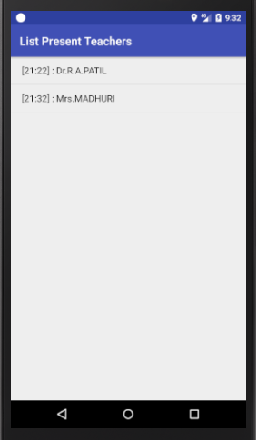
He’s can also edit the timetable if there is minor changes.
Now the HoD can see his today’s schedule by clicking on View timetable.
Also he’s able to view the present teacher’s list .

Slide 10
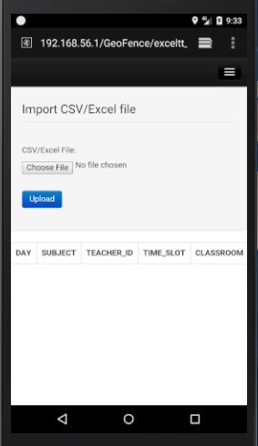
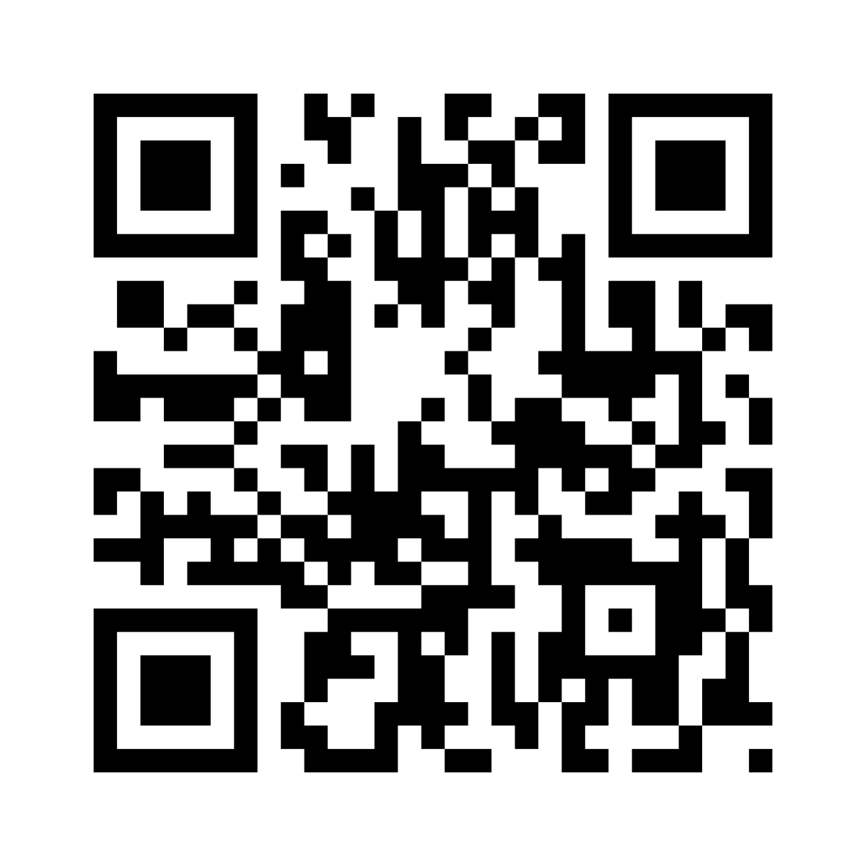
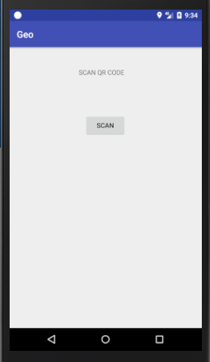
In our app , we can also set the timetable by import the master timetable which is in .csv form.
For checking the availability of classroom , our app has implemented QR code module.

Slide 11
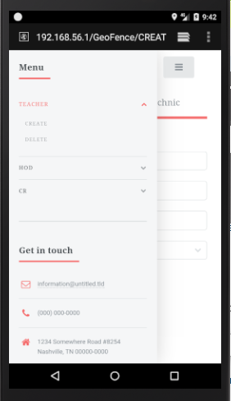
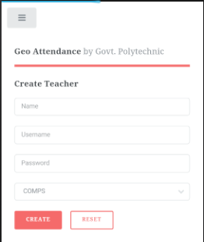
For creation & deletion of HoD & Teacher,the principal has the facility for that.
This facility is only accessible to Principal which follows the level of hierarchy.

Slide 12
Features of proposed system :
Efficient.
Reliable.
Time management.
Cost effective.
Teacher Tracking

Slide 13
Future Scope :-
The security can be more enhanced using face recognition or finger print scanner.
Functionality of Student Attendance-another module can be added for teachers for taking the attendance of student in the same app thus reducing the paper work.
Different Graphical User Interface (GUI) to be integrated with different schools and colleges.
Teachers can be monitored not only within the campus but also in classroom whether they are actually conducting the lectures in classroom or not.

Slide 14
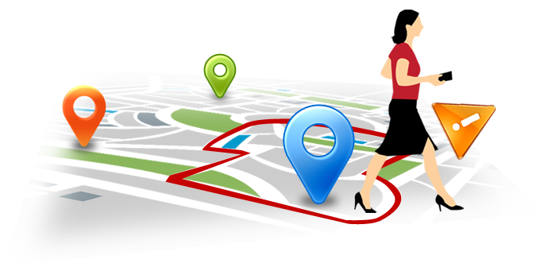
By considering all the facility we’ve made an efficient, reliable and fast app for monitoring the teachers and task management in the cheapest and convenient way so that it saves the time of student or teacher thus utilizing the time and saving the efforts.
ALL THANKS TO GEOFENCING WITH TASK MANAGEMENT!

Slide 15
Thank You!

